Slide 1


模拟电子技术基础
Analog Device
3 Field-effect Transistor (FET)
场效应晶体管
(Chapter 1.4)
Qingfeng Zhang 张青峰
Department of Electrical and Electronic Engineering

Slide 2
3.1 Field-effect transistors (FETs)
FET uses the electric field effect to control the output current
场效应晶体管，简称称场效应管，是利用电场效应来控制输出回路电流的一种半导体器件
Compare FET with BJT:
BJT (Bipolar junction transistor)双极型晶体管:
Current-controlled device 电流控制型器件
Input resistance is small
Both electrons and holes are involved in conduction

Slide 3
FET 场效应晶体管:
High input resistance: 10⁷ ~10¹⁵Ω
Only one type of carriers (electrons or holes) is involved in conduction
Small size, light, low-power consumption, long life span
Low noise, high stability, simple fabrication process
Widely used in large-scale integration circuits

Slide 4
FET 场效应晶体管:
JFET (Junction Field Effect Transistor)
结型场效应管
2. IGFET (Insulated Gate Field Effect Transistor)
绝缘栅型场效应管

Slide 5
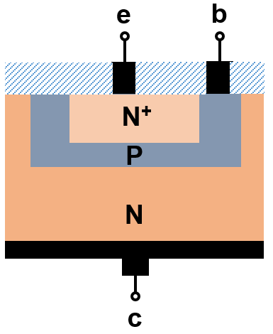
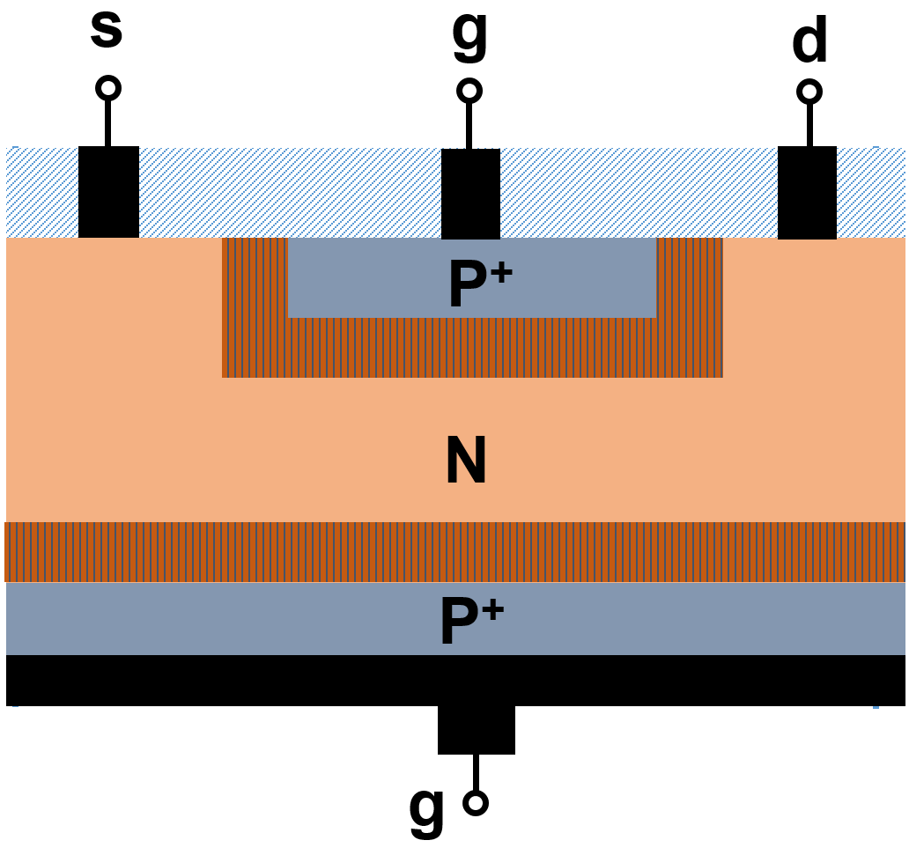
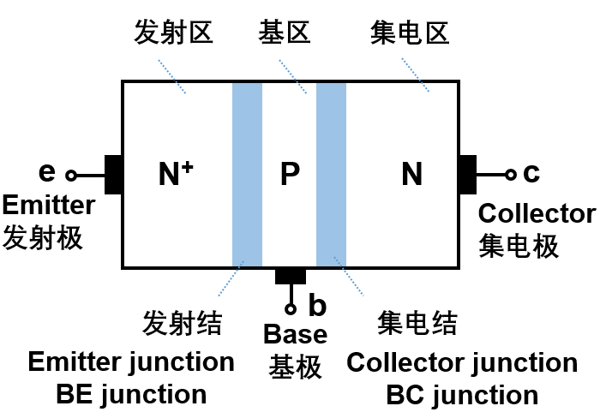
3.2 JFET
BJT
JFET

Slide 6
N-type JFET
Source源极
Gate栅极
Drain漏极
s
g
d
SiO₂ protection layer
P⁺
N
Depletion layer耗尽层
P⁺
d
g
g
s

Slide 7
P-type JFET
Source源极
Gate栅极
Drain漏极
s
g
d
SiO₂ protection layer
N⁺
P
Depletion layer耗尽层
N⁺
d
g
g
s

Slide 8
N-type JFET
u_{DS} (V_{DD})
u_{GS}(V_{GG})
d
s
g
d
g
u_{DS}
(V_{DD})
P⁺
u_{GS}
(V_{GG})
s
N
When u_{GS}=u_{DS}=0:
P⁺
Depletion region is narrow, conduction channel is wide
g

Slide 9
u_{DS} (V_{DD})
1) u_{DS}=0
u_{GS}(V_{GG})
When U_{GS(off)}<u_{GS}<0:
s
g
d
Depletion region becomes wider, conduction channel becomes narrower
P⁺
N
The resistance R_{DS} ↑
P⁺
g

Slide 10
u_{DS} (V_{DD})
1) u_{DS}=0
u_{GS}(V_{GG})
When u_{GS}< U_{GS(off)}:
s
g
d
Depletion regions are connected, conduction channel disappears
P⁺
N
The resistance R_{DS} is extremely large
P⁺
U_{GS(off)} is called gate pinch-off voltage 夹断电压
g

Slide 11
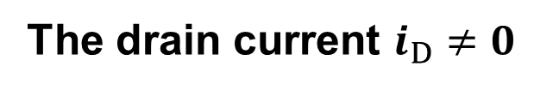

u_{DS} (V_{DD})
2) u_{GS}=0
u_{GS}(V_{GG})
i_{D}
When 0<u_{DS}<|U_{GS(off)}|:
s
g
d
P⁺
The reverse voltage on PN is position-dependent
N
Conduction channel becomes wedge-shaped
P⁺
g

Slide 12

u_{DS} (V_{DD})
2) u_{GS}=0
u_{GS}(V_{GG})
i_{D}
When u_{DS}=|U_{GS(off)}|:
s
g
d
P⁺
N
Pinch-off region is a point
点夹断(预夹断)
P⁺
g

Slide 13

u_{DS} (V_{DD})
2) u_{GS}=0
u_{GS}(V_{GG})
i_{D}
When u_{DS}>|U_{GS(off)}|:
s
g
d
P⁺
N
Pinch-off region becomes wider and longer
夹断区延长
P⁺
g

Slide 14
u_{DS} (V_{DD})
u_{GS}(V_{GG})
i_{D}
s
g
d
P⁺
N
P⁺
g

Slide 15
u_{DS} (V_{DD})
3) u_{GS}<0，u_{DS}>0
u_{GS}(V_{GG})
i_{D}
u_{DS} and u_{GS} will modify the channel shape together
s
g
d
P⁺
When u_{DS}=|U_{GS(off)}|+ u_{GS}
N
or u_{DG}=|U_{GS(off)}|
The channel begins to pinch off
P⁺
g

Slide 16
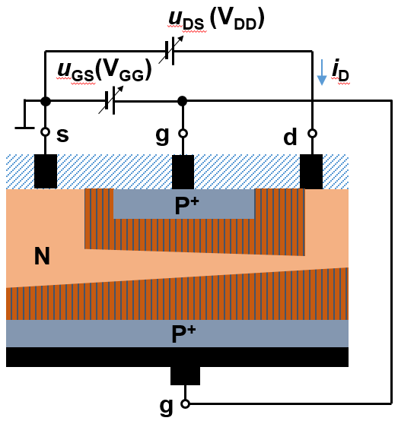

3.2.1 JFET: I-V characteristics
i_{D}
d
i_{G}
g
u_{DS}
(V_{DD})
u_{GS}
(V_{GG})
s
Extremely high input resistance

Slide 17

Output I-V curve
Constant current region恒流区
Variable resistor region可变电阻区
u_{DS}=|U_{GS(off)}|+ u_{GS}
i_{D}
u_{GS}=0V
u_{GS}=-0.5V
u_{GS}=-1V
u_{GS}=-1.5V
u_{GS}=U_{GS(off)}
u_{DS}
Cut-off region 夹断/截止区

Slide 18
u_{DS}=|U_{GS(off)}|+ u_{GS}
Variable resistor region可变电阻区
i_{D}
u_{GS}=0V
u_{GS}=-0.5V
u_{GS}=-1V
u_{DS} is small, the channel are conducting
u_{GS}=-1.5V
u_{DS}<|U_{GS(off)}|+ u_{GS}
u_{GS}=U_{GS(off)}
FET behaves like a resistance-tunable resistor
u_{DS}
Tunable by u_{GS}

Slide 19

u_{DS}=|U_{GS(off)}|+ u_{GS}
Constant current region恒流区
i_{D}
u_{GS}=0V
u_{GS}=-0.5V
u_{DS} is large, channel pinches off 沟道预夹断
u_{GS}=-1V
u_{DS}≥ |U_{GS(off)}|+ u_{GS}
u_{GS}=-1.5V
i_{D} is almost constant, only depends on u_{GS}
u_{GS}=U_{GS(off)}
u_{DS}
Also can be called as amplification region
也称作放大区

Slide 20
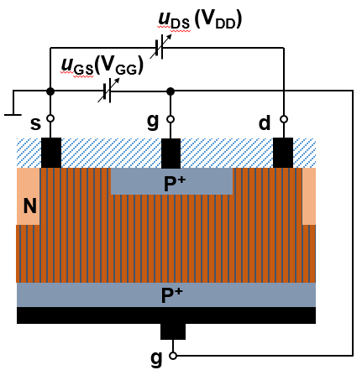

u_{DS}=|U_{GS(off)}|+ u_{GS}
i_{D}
u_{GS}=0V
u_{GS}=-0.5V
Cut-off region 夹断/截止区
u_{GS}=-1V
u_{GS}=-1.5V
Channel fully pinches off
u_{GS}=U_{GS(off)}
u_{GS} < U_{GS(off)}
u_{DS}

Slide 21

Transfer curve 转移特性曲线
i_{D}
i_{D}
u_{DS}=|U_{GS(off)}|+ u_{GS}
u_{GS}=0V
u_{GS}=-0.5V
u_{GS}=-1V
u_{GS}=-1.5V
u_{GS}=U_{GS(off)}
U_{GS(off)}
-1.5V
-1V
-0.5V
0
u_{GS}
u_{DS}
In constant-current region, the transfer curves are independent of u_{DS}
In variable resistor region, the transfer curves depend on u_{DS}

Slide 22
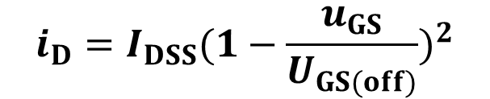

i_{D}
i_{D}
u_{DS}=|U_{GS(off)}|+ u_{GS}
u_{GS}=0V
I_{DSS}
u_{GS}=-0.5V
u_{GS}=-1V
u_{GS}=-1.5V
u_{GS}=U_{GS(off)}
U_{GS(off)}
0
u_{GS}
u_{DS}
At constant-current region:
I_{DSS} is the drain current at u_{GS}=0, u_{DS}>|U_{GS(off)}|

Slide 23
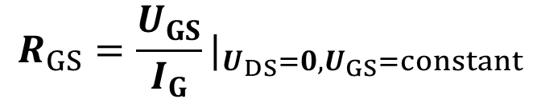
3.2.2 JFET: Key parameters
DC parameters 直流参数
1) Pinch-off voltage U_{GS(off)} 夹断电压
2) Drain saturation current I_{DSS} 漏极饱和电流
I_{DSS} : The drain current at u_{GS}=0, u_{DS}>|U_{GS(off)}|
i_{D}
3) DC Input resistance R_{GS} 直流输入电阻
d
i_{G}
g
u_{DS}
(V_{DD})
u_{GS}
(V_{GG})
s

Slide 24
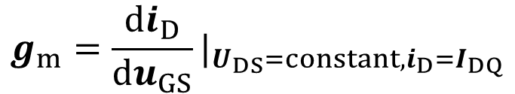
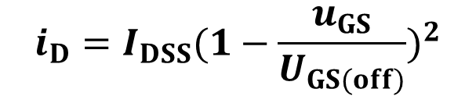
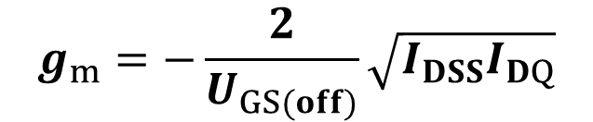
d
AC parameters 交流参数
i_{G}
i_{D}
1) Transconuctance g_{m} 互导/跨导
g
u_{DS}
u_{GS}
s
At constant-current region:
2) There exists capacitance between drain, source and gate: C_{gs}, C_{gd}, C_{ds}
In high frequency circuits, we need to consider C_{gs}, C_{gd}, C_{ds}
Larger I_{DQ}, larger g_{m}

Slide 25
Absolute maximum ratings 极限参数
1) Maximum drain current I_{DSM}
最大漏极电流
d
2) Maximum drain dissipation power P_{DSM}
i_{G}
i_{D}
漏极最大耗散功率
g
3) Gate breakdown voltage U_{(BR)GS}
u_{DS}
u_{GS}
s
栅极击穿电压
4) Drain-source breakdown voltage U_{(BR)DS}
漏源击穿电压

Slide 26
Q1: As shown in the figure，FET has U_{GS(off)}=-5V；Ask: In the three situations listed below, FET works in which region?
i_{D}
1) u_{GS}=-8V, u_{DS}=4V
d
+
2) u_{GS}=-3V, u_{DS}=4V
i_{G}
g
R_{D}
3) u_{GS}=-3V, u_{DS}=1V
+
u_{DS}
R_{G}
i_{S}
s
u_{GS}
V_{DD}
Answer:
V_{GG}
_
_
1) u_{GS}<U_{GS(off)}, in cut-off region
2) u_{DS}>|U_{GS(off)}|+u_{GS}, in constant-current region
3) u_{DS}<|U_{GS(off)}|+u_{GS}, in variable resistor region

Slide 27
3.3 IGFET
IGFET (Insulated Gate Field Effect Transistor)
绝缘栅型场效应管
Enhancement mode
Depletion mode
增强型
耗尽型
N-type
P-type
N-type
P-type

Slide 28
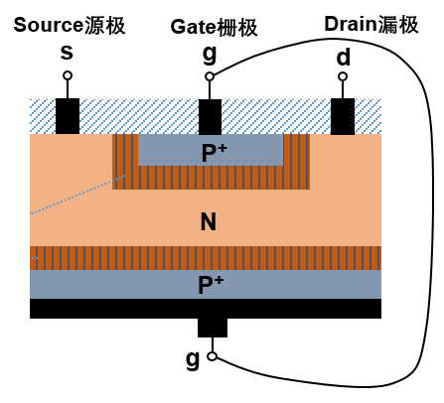
3.3.1 Enhanced N-type IGFET
Gate栅极
Source源极
Drain漏极
s
g
d
Metal
SiO₂ insulated layer
Oxide
Semiconductor
N⁺
N⁺
IGFET is also called:
P
JFET
MOSFET
B

Slide 29
Working principle:
u_{DS}
u_{GS}
i_{D}
s
g
d
N⁺
N⁺
P
B

Slide 30
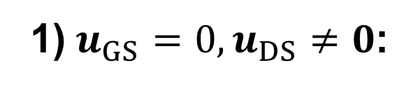
u_{DS}
One PN junction is reversed
u_{GS}=0
i_{D}
i_{D}=0
g
s
d
N⁺
N⁺
P
B

Slide 31
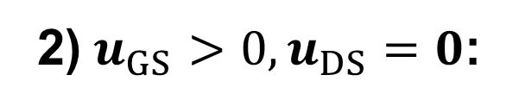
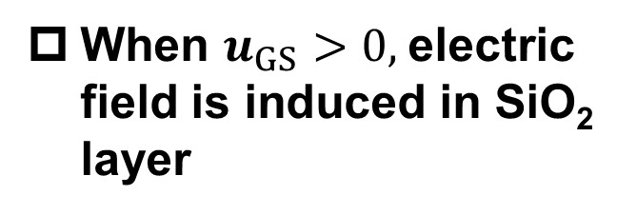
u_{DS}
Gate-SiO₂-Semiconductor can be treated as a parallel-plate capacitor 平行板电容器
u_{GS}
i_{D}
s
g
d
N⁺
N⁺
Electrons are attracted and holes are repulsed to SiO₂ surface
P
B

Slide 32
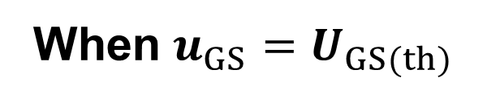
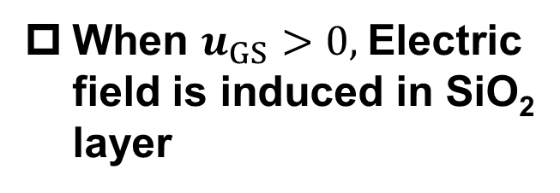
u_{DS}
Gate-SiO₂-Semiconductor can be treated as a parallel-plate capacitor 平行板电容器
u_{GS}
i_{D}
s
g
d
N⁺
N⁺
Electrons are attracted and holes are repulsed to SiO₂ surface
P
Inversion layer (反型层) is formed near SiO₂ surface
B

Slide 33
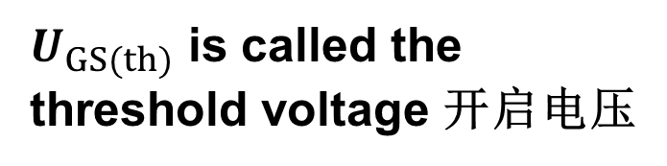
u_{DS}
u_{GS}
i_{D}
Enhanced N-type IGFET is also called NMOS
s
g
d
N⁺
N⁺
P
B

Slide 34
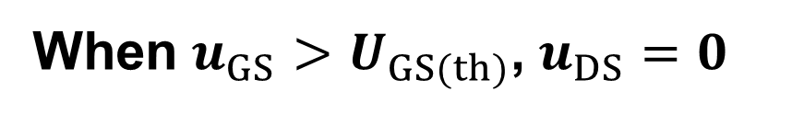
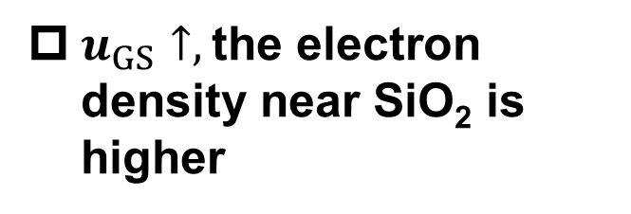
u_{DS}
The electric field in SiO₂ is larger
u_{GS}
i_{D}
s
g
d
N⁺
N⁺
P
B

Slide 35
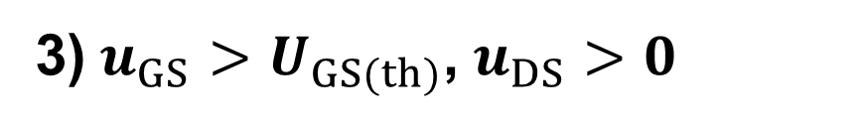




u_{DS}
u_{GS}
i_{D}
s
g
d
The potential of channel near drain is smaller
The electric field in SiO₂ near drain is smaller
N⁺
N⁺
The conducting channel is wedge-shaped 楔形
P
B

Slide 36
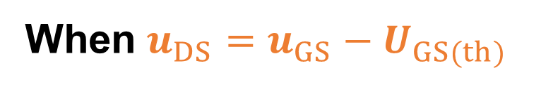
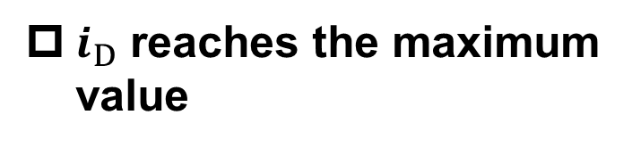
u_{DS}
u_{GS}
i_{D}
s
g
d
NMOS begins to enter the constant current region
N⁺
N⁺
Channel begins to pinch off 沟道预夹断
P
B

Slide 37

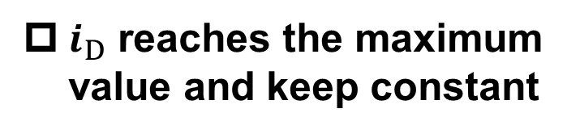
u_{DS}
u_{GS}
i_{D}
s
g
d
NMOS is in constant current region
N⁺
N⁺
The pinch-off region extends 夹断区延长
P
B

Slide 38
u_{DS}
u_{GS}
i_{D}
s
g
d
N⁺
N⁺
P
B

Slide 39

Output I-V curve
Constant current region恒流区
u_{DS}= u_{GS} - U_{GS(th)}
i_{D}
Variable resistor region可变电阻区
u_{GS}>U_{GS(th)}
u_{GS}=U_{GS(th)}
u_{DS}
Cut-off region 夹断/截止区

Slide 40
Variable resistor region可变电阻区
u_{DS}= u_{GS} - U_{GS(th)}
i_{D}
u_{DS} is small, the channel are conducting
u_{DS}< u_{GS} - U_{GS(off)}
FET behaves like a resistance-tunable resistor
u_{GS}=U_{GS(th)}
Tunable by u_{GS}
u_{DS}

Slide 41
Constant current region恒流区
u_{DS}= u_{GS} - U_{GS(th)}
u_{DS} is large, channel pinches off 沟道预夹断
i_{D}
u_{DS} ≥ u_{GS} - U_{GS(th)}
u_{GS} ≥ U_{GS(th)}
i_{D} is almost constant, only depends on u_{GS}
u_{GS}=U_{GS(th)}
Also can be called as amplification region
u_{DS}

Slide 42

Cut-off region 夹断/截止区
u_{DS}= u_{GS} - U_{GS(th)}
i_{D}
Channel fully pinches off
u_{GS} < U_{GS(th)}
u_{GS}=U_{GS(th)}
u_{DS}

Slide 43
Transfer curve 转移特性曲线
i_{D}
i_{D}
u_{DS}= u_{GS} - U_{GS(th)}
u_{GS}=2U_{GS(th)}
U_{GS3}
U_{GS2}
U_{GS1}
u_{GS}=U_{GS(th)}
0
u_{GS}
U_{GS(th)}
2U_{GS(th)}
u_{DS}
In constant-current region, the transfer curves are independent of u_{DS}

Slide 44
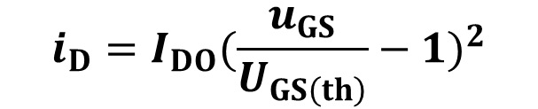

i_{D}
i_{D}
u_{DS}= u_{GS} - U_{GS(th)}
u_{GS}=2U_{GS(th)}
I_{DO}
U_{GS3}
U_{GS2}
U_{GS1}
u_{GS}=U_{GS(th)}
0
u_{GS}
U_{GS(th)}
2U_{GS(th)}
u_{DS}
At constant-current region:
I_{DO} is the drain current at u_{GS}=2U_{GS(th)}

Slide 45
3.3.2 Depleted N-type IGFET/MOSFET
u_{DS}
SiO₂ are doped with positive ions
i_{D}
u_{GS}=0
SiO₂ insulated layer
s
g
d
There is an inversion layer even when u_{DS}=0 and u_{GS}=0
+
+
+
+
+
+
+
+
+
+
N⁺
N⁺
Hence, when u_{DS}>0 and u_{GS}=0, i_{D}>0
P
B

Slide 46
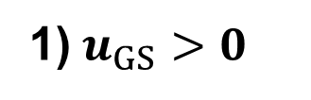
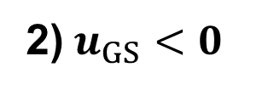

u_{DS}
i_{D}
The inversion layer becomes wider
u_{GS}
s
g
d
+
+
+
+
+
+
+
+
+
+
N⁺
N⁺
The inversion layer becomes narrower
P
B

Slide 47

Output I-V curve
Enhanced NMOS
Depleted NMOS
i_{D}
u_{DS}= u_{GS} - U_{GS(th)}
i_{D}
u_{DS}= u_{GS} - U_{GS(off)}
u_{GS}=2U_{GS(th)}
U_{GS3}
U_{GS2}
u_{GS}=0
U_{GS1}
u_{GS}=U_{GS(th)}>0
u_{GS}=U_{GS(off)}<0
u_{DS}
u_{DS}

Slide 48

Transfer curve 转移特性曲线
i_{D}
Enhanced NMOS
Depleted NMOS
U_{GS(off)}
0
U_{GS(th)}
u_{GS}

Slide 49
3.3.3 Summary
JFET
Enhanced MOSFET
Depleted MOSFET
N
d
N
d
N
d
B
B
g
g
g
s
s
s
d
P
d
d
P
P
B
B
g
g
g
s
s
s

Slide 50
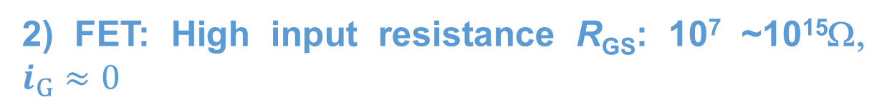
FET 场效应晶体管 (Compared with BJT)
Gate(栅极), source(源极), and drain(漏极) in FET corresponds to the base(基极), emitter(发射极), and collector(集电极) in BJT
1) FET: Use voltage u_{GS} to control current i_{D}
BJT: Use current i_{B} to control current i_{C}
BJT: Low input resistance R_{EB}

Slide 51
3) FET: Only one type of carriers (electrons or holes) is involved in conduction
BJT: Both electrons and holes are involved in conduction
4) FET: Small size, light, low-power consumption, long life span
5) FET: The device structure is symmetric, hence source and drain can be exchanged
6) FET: The size of FET is only about 5% of that of BJT. Hence it is widely used in large-scale integration circuits

Slide 52
7) FET: The transconductance is smaller than that of BJT. With similar load resistance, the voltage gain is usually smaller than that of BJT.
8) FET: FET is more vulnerable to environment electrostatic charges. The high input resistance and ultra-thin insulating layer make charges accumulate in FET, and breakdown the insulating layer. 由于MOS管的输入电阻高，由外界感应产生的电荷不易泄露，而栅极上的绝缘层又很薄，这将在栅极上产生很高的电场强度，以致引起绝缘层的击穿而损坏管子。

